Slide 1




NEURAL NETWORKS,
HOW DO THEY WORK?
BY JOE ORTIZ, LEILA KANDIL, LOIC SHYAKA NGABO, AND MAX VALLADOLID

Slide 2


WHAT ARE NEURAL NETWORKS?
Consider the following numbers
We automatically understand what each number is.
How could a learning module understand this same thing?
Notes:
Our brain automatically knows how to process what these numbers are. Neural Networks are computational models that try to mirror this process of the brain. a neural network uses layers of artificial neurons—simple decision-making units—to analyze input and improve predictions over time.
Neural networks aim to mimic hte brain to try and classify things like images words.

Slide 3
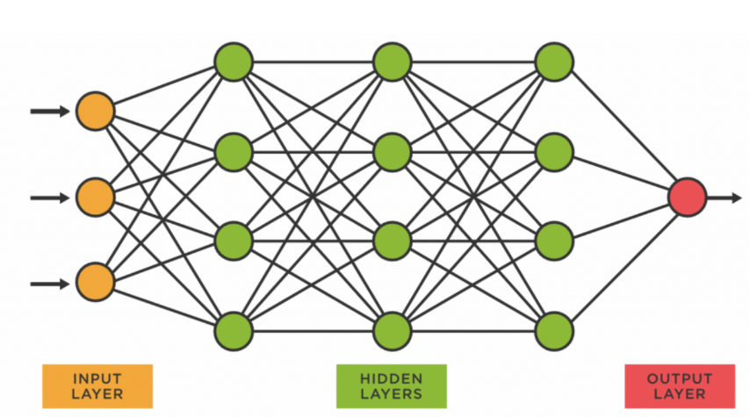
HOW NEURAL NETWORKS WORK
Notes:
When it comes to coding neural networks I would like to refer back to the image. Just thinking about it it would go something like this: We start with some sort of input data, which we want to move forward, (important to note that we only want it to move forward) into another layer of data, called the hidden layer.
We can have as many of these as we want, but for the purposes of this example just imagine there are three layers. The first layer feeds into the second, the second layer feeds into the third (Weights factor in somehow?) until we get to the output layer. Our code needs to pipe each layer into the next, accounting for the weights. All of this happens with matrix multiplication. Imagine each of these dots (inputs) as it's own matrix. We can multiply them together and get some sort of result.
Pytorch is an open source machine learning module that contains all the tools necessary to create Neural networks. NumPy contains all the information like addition subtraction, multiplication etc. We can think of Pytorch similarly. it contains all the information needed for encoding, storing tensors, optimizing the algorithm, etc, and one of the biggest things is GPU acceleration, which allows it to handle the large matrix multiplication needed to create neural networs.

Slide 4
Input Data
HOW NEURAL NETWORKS WORK
Input data - like an image or sentence
Notes:
When it comes to coding neural networks I would like to refer back to the image. Just thinking about it it would go something like this: We start with some sort of input data, which we want to move forward, (important to note that we only want it to move forward) into another layer of data, called the hidden layer. We can have as many of these as we want, but for the purposes of this example just imagine there are three layers. The first layer feeds into the second, the second layer feeds into the third (Weights factor in somehow?) until we get to the output layer. Our code needs to pipe each layer into the next, accounting for the weights. All of this happens with matrix multiplication. Imagine each of these dots (inputs) as it's own matrix. We can multiply them together and get some sort of result.
Pytorch is an open source machine learning module that contains all the tools necessary to create Neural networks. NumPy contains all the information like addition subtraction, multiplication etc. We can think of Pytorch similarly. it contains all the information needed for encoding, storing tensors, optimizing the algorithm, etc, and one of the biggest things is GPU acceleration, which allows it to handle the large matrix multiplication needed to create neural networs.

Slide 5
Input Data
HOW NEURAL NETWORKS WORK
Input data - like an image or sentence
Each layer passes information to the next, applying weights
Weights
Notes:
When it comes to coding neural networks I would like to refer back to the image. Just thinking about it it would go something like this: We start with some sort of input data, which we want to move forward, (important to note that we only want it to move forward) into another layer of data, called the hidden layer. We can have as many of these as we want, but for the purposes of this example just imagine there are three layers. The first layer feeds into the second, the second layer feeds into the third (Weights factor in somehow?) until we get to the output layer. Our code needs to pipe each layer into the next, accounting for the weights. All of this happens with matrix multiplication. Imagine each of these dots (inputs) as it's own matrix. We can multiply them together and get some sort of result.
Pytorch is an open source machine learning module that contains all the tools necessary to create Neural networks. NumPy contains all the information like addition subtraction, multiplication etc. We can think of Pytorch similarly. it contains all the information needed for encoding, storing tensors, optimizing the algorithm, etc, and one of the biggest things is GPU acceleration, which allows it to handle the large matrix multiplication needed to create neural networs.

Slide 6
Input Data
New Layer
HOW NEURAL NETWORKS WORK
Input data - like an image or sentence
Each layer passes information to the next, applying weights
Input goes to first hidden layer
Weights
Notes:
When it comes to coding neural networks I would like to refer back to the image. Just thinking about it it would go something like this: We start with some sort of input data, which we want to move forward, (important to note that we only want it to move forward) into another layer of data, called the hidden layer. We can have as many of these as we want, but for the purposes of this example just imagine there are three layers. The first layer feeds into the second, the second layer feeds into the third (Weights factor in somehow?) until we get to the output layer. Our code needs to pipe each layer into the next, accounting for the weights. All of this happens with matrix multiplication. Imagine each of these dots (inputs) as it's own matrix. We can multiply them together and get some sort of result.
Pytorch is an open source machine learning module that contains all the tools necessary to create Neural networks. NumPy contains all the information like addition subtraction, multiplication etc. We can think of Pytorch similarly. it contains all the information needed for encoding, storing tensors, optimizing the algorithm, etc, and one of the biggest things is GPU acceleration, which allows it to handle the large matrix multiplication needed to create neural networs.

Slide 7
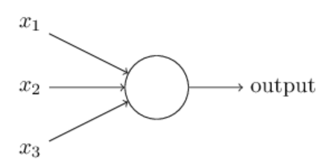
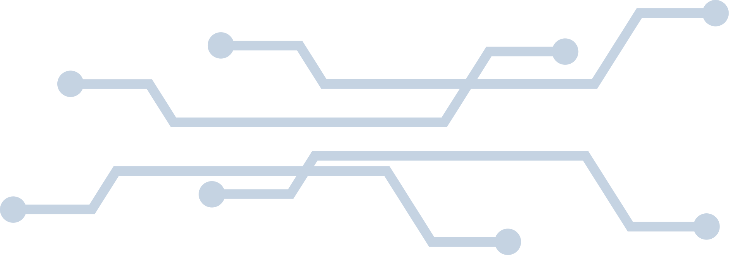
PERCEPTRON
A perceptron is the simpliest type of artificial neuron
Weights
Binary
Binary
Threshold
Notes:
Perceptrons take multiple inputs and produces a single binary output (0 or 1). The output is determined by whether the weighted input values meet a certain threshold. This is similar to confusion matrix prediction models, where values above 0.5 are considered ‘true’ and values below are considerd false. Basically perceptraons are capable of taking in information, applying proper weights, and then making decisions.
Important to note that this acts as a binary classifier. it either predicts that something is or isn't one thing(yes no)

Slide 8
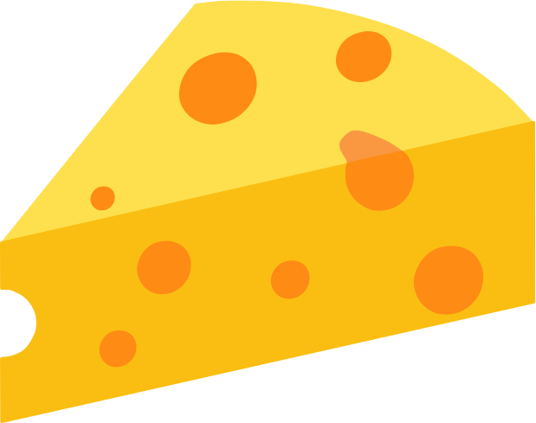
PERCEPTRONS EXPLAINED
John wants to go to a cheese festival, and there are 3 factors that would impact his decision.
Public transport because John doesn’t have a car
The Weather
Whether John has a friend to go with him
Notes:
Perceptrons take multiple inputs and produces a sigle binary output (0 or 1). The output is determined by whether the weighted input values meet a certain threshold. This is similar to confusion matrix prediction models, where values above 0.5 are considered ‘true’ and values below are considerd false

Slide 9
CHEESE FESTIVAL
The Idea is that each of these factors contributes to the decision john makes.
BUT they have different weights
Notes:
Perceptrons take multiple inputs and produces a sigle binary output (0 or 1). The output is determined by whether the weighted input values meet a certain threshold. This is similar to confusion matrix prediction models, where values above 0.5 are considered ‘true’ and values below are considerd false

Slide 10
CHEESE FESTIVAL
The Idea is that each of these factors contributes to the decision john makes.
BUT they have different wieghts
Threshold = 5
Binary
Weather
Company
Transportation
x6
x2
x2
Notes:
Perceptrons take multiple inputs and produces a sigle binary output (0 or 1). The output is determined by whether the weighted input values meet a certain threshold. This is similar to confusion matrix prediction models, where values above 0.5 are considered ‘true’ and values below are considerd false

Slide 11
CHEESE FESTIVAL
The Idea is that each of these factors contributes to the decision john makes.
BUT they have different wieghts
Threshold = 5
Binary
Weather
Company
Transportation
x6
x2
6
x2
Notes:
Perceptrons take multiple inputs and produces a sigle binary output (0 or 1). The output is determined by whether the weighted input values meet a certain threshold. This is similar to confusion matrix prediction models, where values above 0.5 are considered ‘true’ and values below are considerd false

Slide 12
CHEESE FESTIVAL
The Idea is that each of these factors contributes to the decision john makes.
BUT they have different wieghts
Threshold = 5
Binary
Weather
Company
Transportation
x6
x2
4
x2
Notes:
Perceptrons take multiple inputs and produces a sigle binary output (0 or 1). The output is determined by whether the weighted input values meet a certain threshold. This is similar to confusion matrix prediction models, where values above 0.5 are considered ‘true’ and values below are considerd false

Slide 13
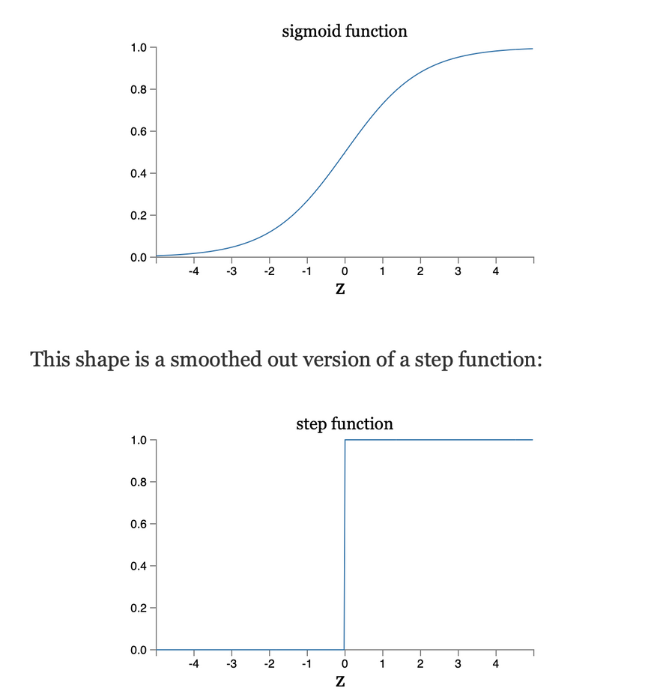
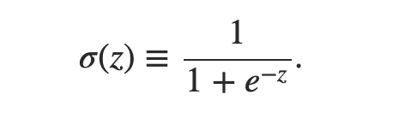
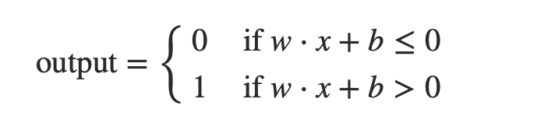
MATH INVOLVED
X= Inputs
W= Weights
B= Bias
Notes:
The sigmoid doesn't do just yes or no, it can output values from 0-1 giving a measurable confidence. Sigmoid is much more commonly used as it allows the neural networks to make smarter, probability-based decisions.
Going back to the cheese example where John would only go if a certain threshold was met, the sigmoid function would instead produce a percent chance that john would go to the festival if there were any factors. So if there was good weather it would be a 95% chance, but if he could get a friend and transportation, but it was bad weather, maybe it would only be 40%.

Slide 14
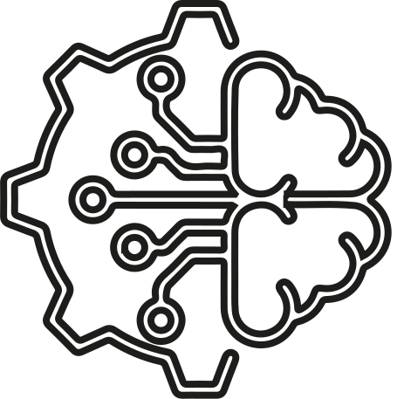
six tabular methods that reflect how neural networks are advancing in structured data modeling
What are tabular methods?
Specialized techniques for handling structured data organized in tables (rows = instances, columns = features)
Why they matter?
Tabular data is extremely common across industries:
Healthcare
Finance
E-commerce
Manufacturing
Energy
The challenge:
Finding the best approaches to process this structured data effectively

Slide 15


MLP variants: Enhanced versions of standard Multi-Layer Perceptrons
1.
What are MLP variants?
SIX MAIN APPROACHES FOR DEEP NEURAL NETWORKS ON TABULAR DATA
They’re improved versions of a basic type of artificial intelligence model called a Multi-Layer Perceptron (MLP)
Like a really smart calculator made of layers that help computers learn patterns in data.

Slide 16


Real-world applications
1- Customer Segmentation in Marketing
Grouping customers based on what they buy.
Advantage: Simple to set up, making it easier for business teams to use.
2- Financial Forecasting
Predicting things like market trends and financial outcomes.
Advantage: Special features in models like ResNet help keep information flowing for more accurate predictions.
3- Fraud Detection
Spotting suspicious transactions, like credit card fraud.
Advantage: Advantage: RealMLP is good at handling yes/no outcomes (like fraud or not).
Why they are useful
Challenges
Easy to use, even if you don’t have deep knowledge in AI.
Flexible: They work well for a variety of prediction tasks.
Some versions, like SNN (Self-normalizing neural network) , are good for working with messy or inconsistent data.
They can miss complex connections between data points.
They often work similarly to each other, so there’s not always a huge advantage in picking one version over another.
They may need more fine-tuning than other methods (like decision trees) for specific tasks.

Slide 17

Special Designed Architectures
2.
What are they?
SIX MAIN APPROACHES FOR DEEP NEURAL NETWORKS ON TABULAR DATA
They’re custom-built neural networks made to work really well with tabular data.
Like data you’d see in spreadsheets, with rows and columns. Specially-designed tools for a specific job, like a pizza cutter vs. a regular knife

Slide 18


Real-world applications
1- Product Recommendations
Like when a website says, “Customers who bought this also bought…”
Advantage: Captures hidden connections between what people like and what they might want next.
2- Dynamic Pricing
Changing prices based on demand, season, or user type.
Advantage: Can handle complex situations and help businesses adjust prices smartly.
3- User Behavior Analysis
Figuring out how people use a website or app.
Advantage: Finds patterns in user actions, helping improve design or marketing.
Why they are useful
Challenges
Some models are good at finding both obvious and hidden patterns.
Others can group related features to spot helpful trends.
TabCaps give a richer way to represent data, which can lead to better results.
They need a lot more data to work well.
They use more computing power, which can cost more.
Might be too complicated for simpler tasks where basic models are enough.

Slide 19

Token Based Methods: Converting Data into Processable Representations
3.
What are they?
SIX MAIN APPROACHES FOR DEEP NEURAL NETWORKS ON TABULAR DATA
Turn pieces of data into high-dimensional vectors (tokens)
Like unique puzzle pieces, so a model can better understand patterns and spot connections in spreadsheets or tables.

Slide 20


Real-world applications
1- Click-Through Rate Prediction
Guessing if someone will click on an ad.
Advantage: Can find hidden patterns between what an ad says and what a user might like.
2- Ad Campaign Optimization
Making ads more effective.
Advantage: Understands how all the parts of an ad campaign work together.
3- Content Recommendation
Suggesting videos, products, or articles you might like.
Advantage: Can figure out how different pieces of content relate to each other.
Why they are useful
Challenges
Can handle many types of data (like numbers, categories, and text).
Great at finding complex connections in data.
Some models, like ExcelFormer, can ignore the stuff that doesn’t matter, reducing noise.
They need more computing power, which can be expensive.
Harder to build and manage than simpler models.
Sometimes, the extra complexity doesn’t lead to much better performance.

Slide 21

Regularization-Based Methods: Preventing Overlearning
4.
What are they?
SIX MAIN APPROACHES FOR DEEP NEURAL NETWORKS ON TABULAR DATA
Techniques that guide or limit how a neural network learns, so it doesn’t “overthink” or memorize the training data too much
Like a student learning the main ideas instead of just memorizing test answers.

Slide 22


Real-world applications
1- Risk Assessment
Used to figure out financial or safety risks.
Advantage: TANGOS makes the AI better at understanding complex risk factors.
2- Anomaly Detection
Helps spot rare or unusual patterns—like errors or fraud.
Advantage: These methods help the AI stay general enough to notice things it hasn't seen before.
3- Medical Diagnosis Support
Assists doctors in identifying health issues.
Advantage: PTaRL compares new patient data to known cases, which makes the AI’s decision more trustworthy and easier to understand.
Why they are useful
Challenges
TANGOS helps different parts of the AI focus on different features (like teamwork).
SwitchTab is great when you don’t have a lot of labeled examples to learn from.
PTaRL improves accuracy by comparing data to "typical" examples (prototypes).
They’re harder to build and need technical know-how.
You have to carefully adjust them so they don’t over-limit the model.
Training might take longer and need more computer power.

Slide 23

Tree-Mimic Methods: Combining Decision Tree Logic with Neural Networks
5.
What are they?
SIX MAIN APPROACHES FOR DEEP NEURAL NETWORKS ON TABULAR DATA
Neural networks designed to behave a bit like decision trees — the kind of models that ask yes/no questions to make decisions.
Like combining the creativity of a human (neural networks) with the clear decision-making of a flowchart (decision trees).

Slide 24


Real-world applications
1- Credit Scoring
Helping banks decide who should get a loan.
Advantage: NODE makes decisions that are easier to explain to regulators.
2- Predictive Maintenance
Predicting when machines will break down.
Advantage: GrowNet can handle lots of different machine-related factors.
3- Insurance Underwriting
Deciding who qualifies for insurance.
Advantage: TabNet highlights which info mattered most in the decision.
Why they are useful
Challenges
Can explain how they made decisions, which is important in industries like finance and healthcare
NODE is great at blending decision logic with flexible learning
TabNet shows which pieces of info it focused on
Doesn’t always use the full power of neural networks
Can be trickier to set up than simpler models
May be too complex for basic problems

Slide 25

Context-Based Methods: Learning From Similar Examples
6.
What are they?
SIX MAIN APPROACHES FOR DEEP NEURAL NETWORKS ON TABULAR DATA
Models that make predictions by looking at examples that are similar to the current case
Like if you’re trying to decide which movie to watch, and you pick one based on what similar people enjoyed.

Slide 26


Real-world applications
1- Personalized Medicine
Creating treatments tailored to individual patients.
Advantage: ModernNCA looks for similar cases to suggest the best treatment for each person.
2- Market Segmentation
Grouping similar customers or products together.
Advantage: Automatically sorts similar items or people into categories.
3- Customer Churn Prediction
Predicting which customers might leave.
Advantage: TabR identifies patterns from customers who have left before
Why they are useful
Challenges
Works well across many different areas
Minimal setup needed, saving time on development
TabPFN doesn’t need much tuning, so it’s easier to use
TabPFN only works for smaller tasks
Can slow down with large datasets and may lose some information
Requires sampling, which might miss key details from big data sets

Slide 27



EMBEDDING LAYERS
*DUMMY DATA*
Translates categories into numbers
Stores them as compact vectors (lists of numbers) the model can learn from
Helps the model find relationships between different categories
“King” and “Queen” have similar embeddings both royalty
[0.9, 0.2, 0.1]
[0.88, 0.25, 0.12]

Slide 28
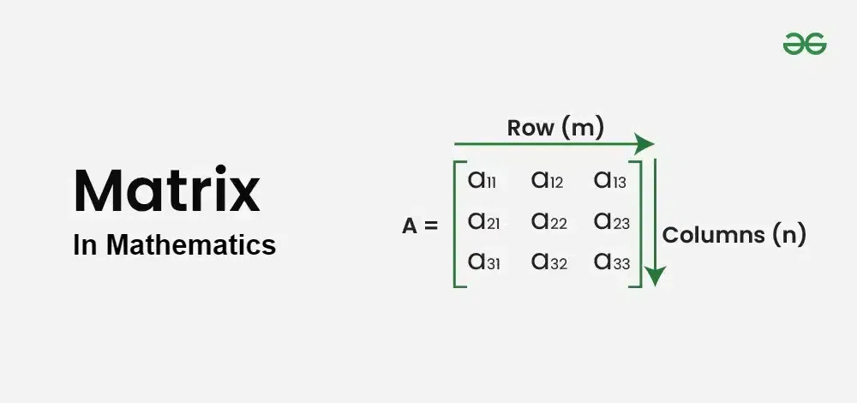
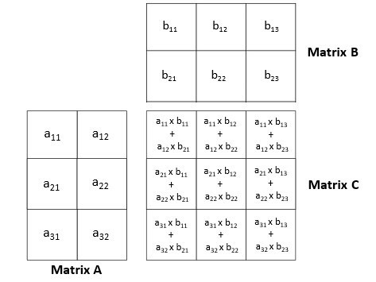
MATH INVOLVED
MATRIX MULTIPLICATION
RULES: For any two matrices for multiplication to be possible the number of columns of the first one has to equal the number of rows for the second one

Slide 29
IMPORTANCE OF EMBEDDING
Handles columns with many unique values more efficiently
Help models learn and group similar items automatically
Reduce input size and improve prediction performance

Slide 30
CODING
What would the code for this look like?
We can do this using PyTorch!
Notes:
When it comes to coding neural networks I would like to refer back to the image. Just thinking about it it would go something like this: We start with some sort of input data, which we want to move forward, (important to note that we only want it to move forward) into another layer of data, called the hidden layer. We can have as many of these as we want, but for the purposes of this example just imagine there are three layers. The first layer feeds into the second, the second layer feeds into the third (Weights factor in somehow?) until we get to the output layer. Our code needs to pipe each layer into the next, accounting for the weights. All of this happens with matrix multiplication. Imagine each of these dots (inputs) as it's own matrix. We can multiply them together and get some sort of result.
Pytorch is an open source machine learning module that contains all the tools necessary to create Neural networks. NumPy contains all the information like addition subtraction, multiplication etc. We can think of Pytorch similarly. it contains all the information needed for encoding, storing tensors, optimizing the algorithm, etc, and one of the biggest things is GPU acceleration, which allows it to handle the large matrix multiplication needed to create neural networs.

Slide 31
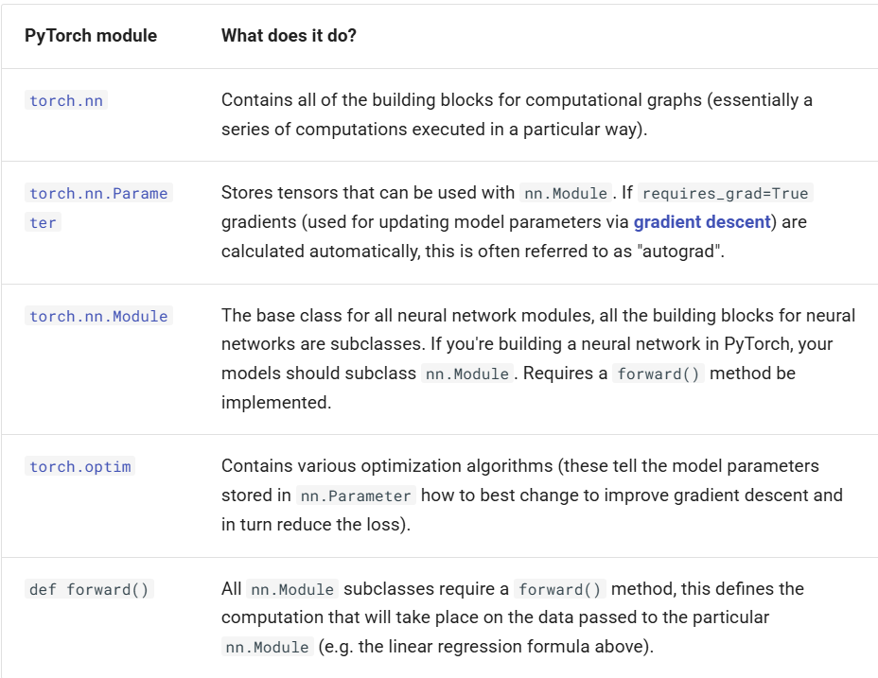
IMPORTANT PYTORCH FUNCTIONS
Notes:
Torch.nn - Main model where everything is stores. Almost everything in a Pytorch Neural Network comes from here
Torch.nn.parameter - calculates the weights and biases. Updates via Gradient descent. Imagine that you are on a hil trying to get down. You can feel the gravity, and walk donwards. Similarly Gradient descent takes difference between predicitons and their true values and slowly works behind the scenes to walk down the hill, and bridge the gap between the the model predictions, and the true values
Torch.nn.Module - Skeleton of the model that allows you to essentially do all the things like define layers, parameters(your weights and biases) and how the data flows (def foward)
torch.optim - Improves module by updating the weights after every prediction
def foward() - makes the model flow foward like we need it to

Slide 32
IMPORTANT PYTORCH FUNCTIONS
Main Module
Framework for models
Calculates weights and biases
Improves model through gradient decent
How data flows
Notes:
Torch.nn - Main model where everything is stores. Almost everything in a PyTorch neural Network comes from here
Torch.nn.parameter - calculates the weights and biases. Updates via Gradient descent. Imagine that you are on a hil trying to get down. You can feel the gravity, and walk donwards. Similarly Gradient descent takes difference between predicitons and their true values and slowly works behind the scenes to walk down the hill, and bridge the gap between the the model predictions, and the true values
Torch.nn.Module - Skeleton of the model that allows you to essentially do all the things like define layers, parameters(your weights and biases) and how the data flows (def foward)
torch.optim - Improves module by updating the weights after every prediction
def foward() - makes the model flow foward like we need it to

Slide 33
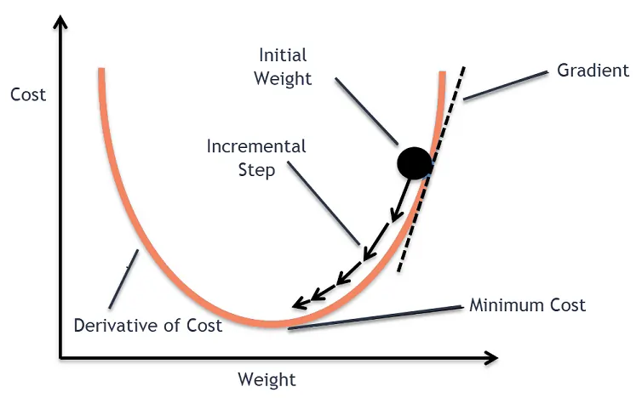
Gradient Decent

Slide 34
Gradient Descent
Key terminology
Loss: measurement of how wrong the prediction is
Epochs: One pass through the training data
Minimum cost: Lowest amount of error the model can have
Backpropagation: how the model figures out which weights to change, and by how much
Ultimately gradient descent is the learning process of the module
Notes:
During each epoch, the model sees every piece of training data once. For each piece, it runs through all the layers, makes a prediction, calculates how wrong it is, and updates its weights. After going through all the data, that’s one epoch. Then it repeats this process for more epochs to keep improving
Backpropagation is how the model figures out which weights to change, and by how much. It works backward from the error, calculating how each weight contributed to that error, so the model can improve

Slide 35
PyTorch Example

Slide 36

THANK YOU.

